Slide 1
Graphing with chartist
Using chartist.js to create visualizations on the web

Slide 2
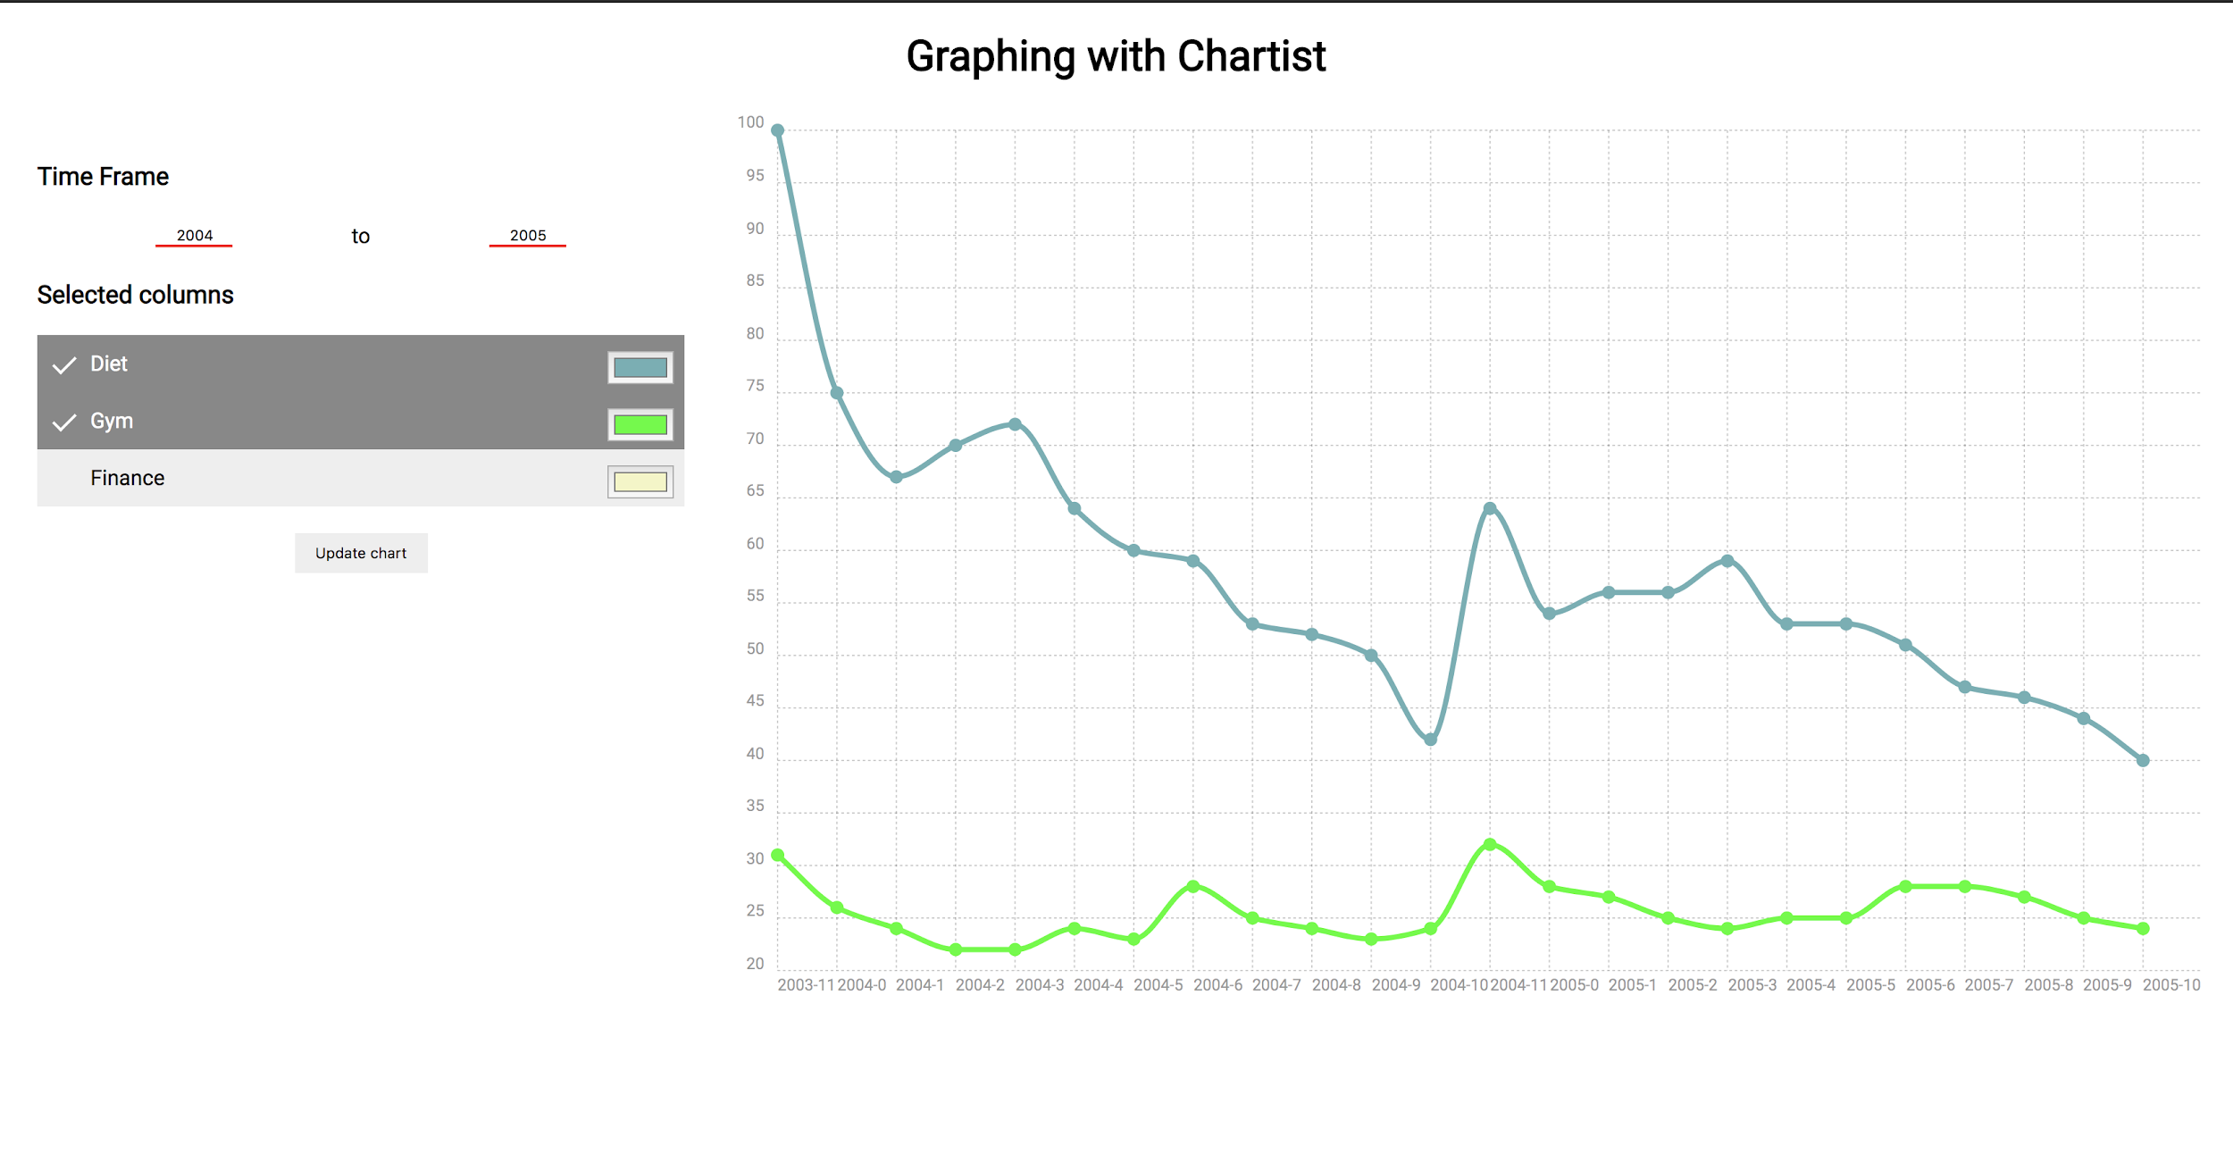

Slide 3
Prerequisites
Backend dependencies
Flask - Web server
Pandas - Data processing
virtualenv - environment isolation (optional)
Frontend dependencies
Chartist.js
axios
Etc.
The csv containing the data we need

Slide 4
Getting started
Inside of a new directory, we’re going to need:
app.py
templates folder containing:
index.html
static folder container:
index.js
index.css (we’re not going to focus on styling choices made)
multiTimeline.csv

Slide 5
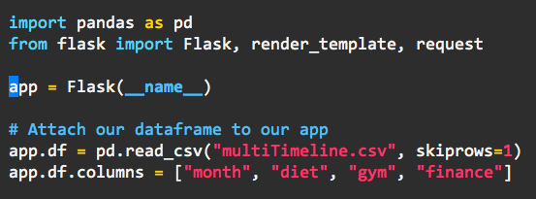
app.py
Our app.py is the backend portion of the application. The first things that need to be imported are the
pandas - For data processing
flask - For web hosting
We setup our flask application and then attach df, the pandas dataframe, to the application.

Slide 6
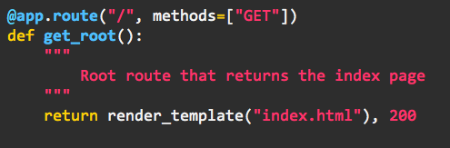
get_root
Inside of our app.py, we define a get_root method for obtaining the index.html file we had specified earlier.
@app.route(...) - Function decarator that converts our function get_root into the route handler for the route and methods we specify
render_template - will render index.html (currently empty)
200 - the http response status code

Slide 7
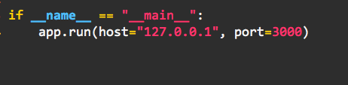
Running our server
In order to run our server, we need to add two more lines of code to the bottom of our.
app.run() - tells the flask server to start. The options that are passed in, host and port, tell flask the host ip address and port of that host to run on.

Slide 8
Setting up our frontend

Slide 9
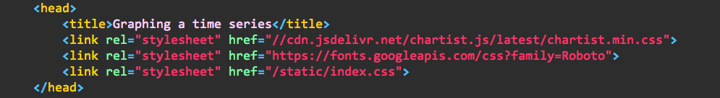
The head and body of the beast
Inside of the header we simply just set the title of the page and grab the styling sheets we will need for our web page.

Slide 10
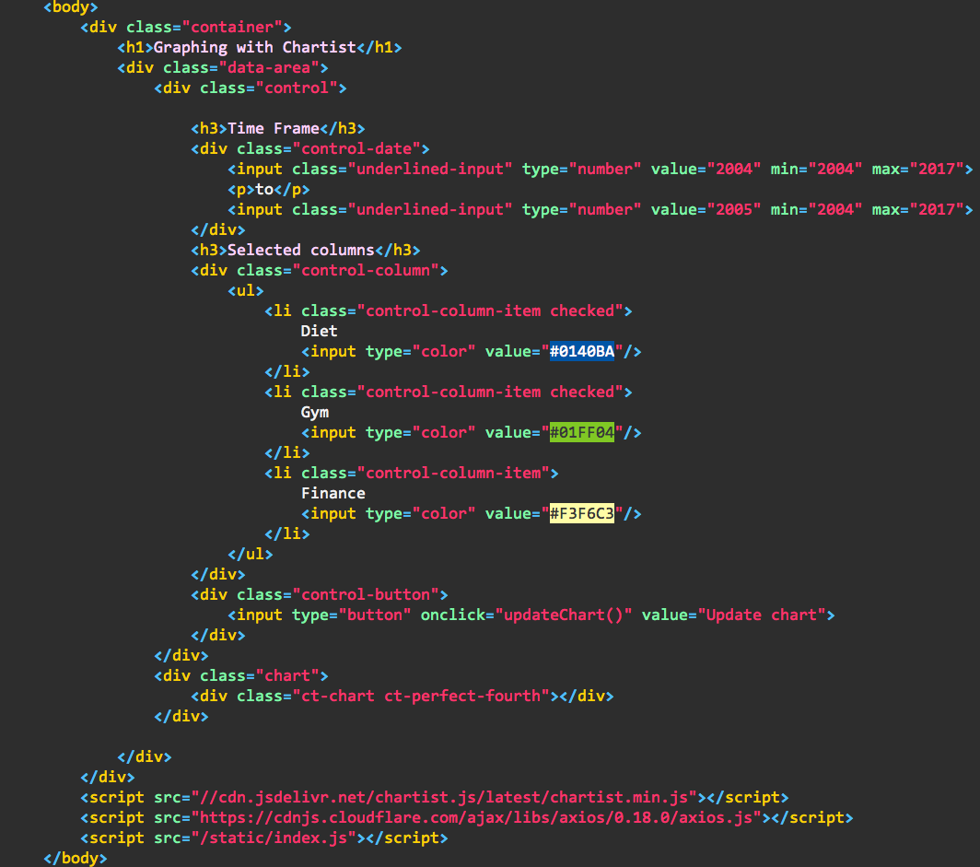

Slide 11
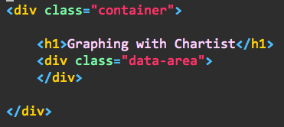
Breaking it down
First, we setup a div called container that will wrap our entire application. Inside we also create another div that will be used for wrapping the “data area” of the application

Slide 12
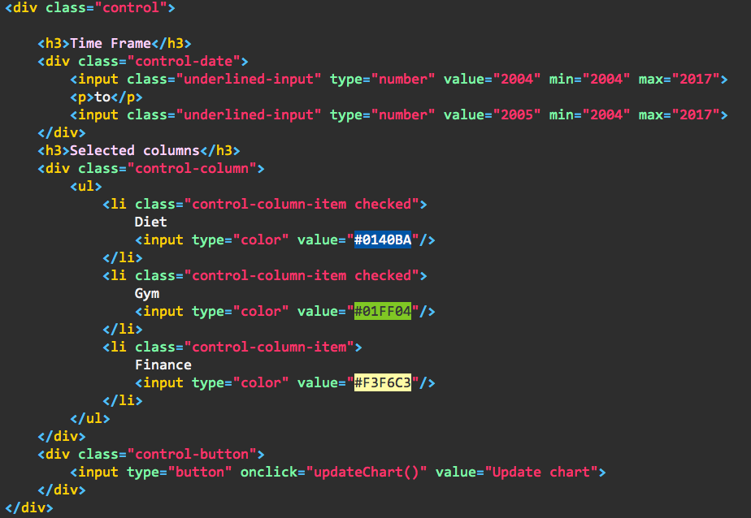
Controlling our data
This next div, control, will allow us to control the graph itself.
The control-date div is what we will use to control the time frame that is selected.
The control-column div is what we will use to control the columns selected from the dataframe.
The control-button div is what we will use to update our chart.

Slide 13

Charting it
This last div will be the chart itself.
The outter div labelled by the class chart is used to wrap the div that will actually be drawing the chart.
ct-chart - is a class provided by Chartist that is used for rendering charts
ct-perfect-fourth - is another class provided by chartist used for maintaining the 4:3 aspect ratio of the chart.

Slide 14
Wrapping up
To wrap up, we add some script tags right before the end of the body to add the functionality

Slide 15
Sending and receiving data

Slide 16
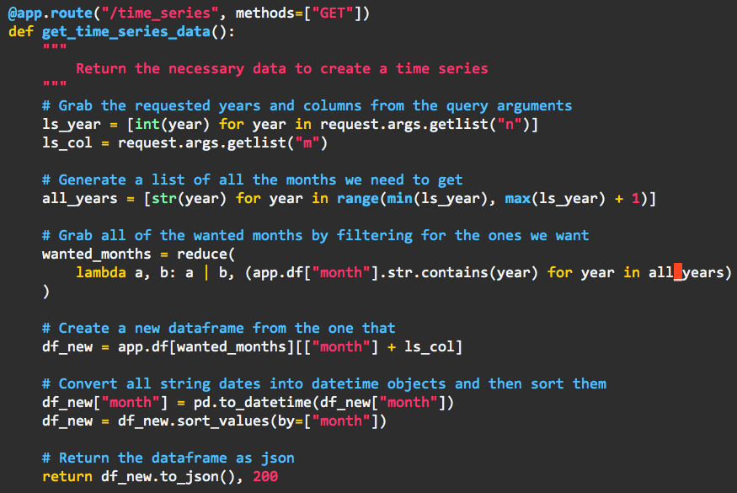
back to our app.py
Right under our get_root route, we create a new function that will be used to handle sending time series data based on the request we will be sending in the future. This is a lot to look at, so let’s break it down.

Slide 17

Parsing the query parameters
Our request is going to be structured like this:
GET http://localhost/time_series?n=2004&n=2005&m=diet&m=fitness
As we can see, we have two query params, n and m. (horrible naming convention)
n corresponds to the time frame, while m corresponds to the specific category.
Since we reuse the query params for multiple values, they’re provided as lists in which we need to parse through.

Slide 18
Time is an issue.
Because we’re presented only two dates, we have a problem. Given the two years 2004 and 2007 through our query parameters, we only have those two years. What we can do is given those two years is generate a list of all the years from the earlier occuring year to the later occurring one. By doing so, we are now able to grab all the data needed to fulfill the timeframe we’d like to select.

Slide 19
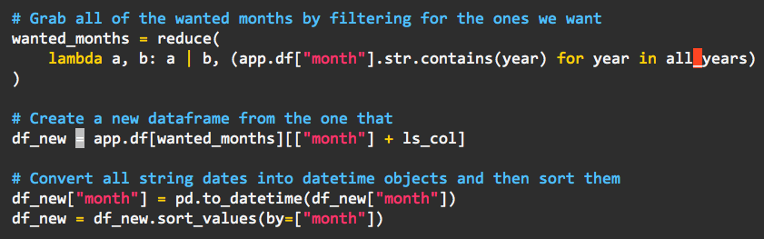
Grabbing the dates we want
First, we call reduce to reduce the values of multiple dataframes into one by using lambda a, b: a | b., where a is the accumulated dataframe and b is the value we’re running a bitwise OR on. The dataframes we grab are ones that contain the years that we’re looking for. We then create a new dataframe, consisting of the month and all the other columns that were passed into the route as query parameters (m). We then convert the month columns into datetime objects for sorting.

Slide 20

Returning a response

Slide 21
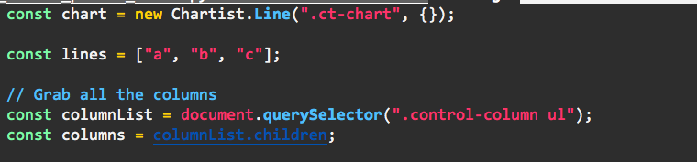
Creating a chart and grabbing input.
in the first line, we create our chart using new Chartist.Line(“.ct-chart”, {}). This grabs the chart div we specified earlier, and instantiates it with no data.
Next we create an array of lines. These lines will be explained later, but essentially deal with updating our chart.
columnList and columns are the inputs for the from our control column.

Slide 22
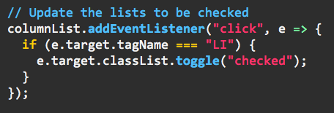
Adding functionality to our input
Using the input column list we previously defined, we add an event listener to it to toggle a “checked” class for signifying that this column was checked. This will be handy both in terms of aesthetic and functional purpose.

Slide 23
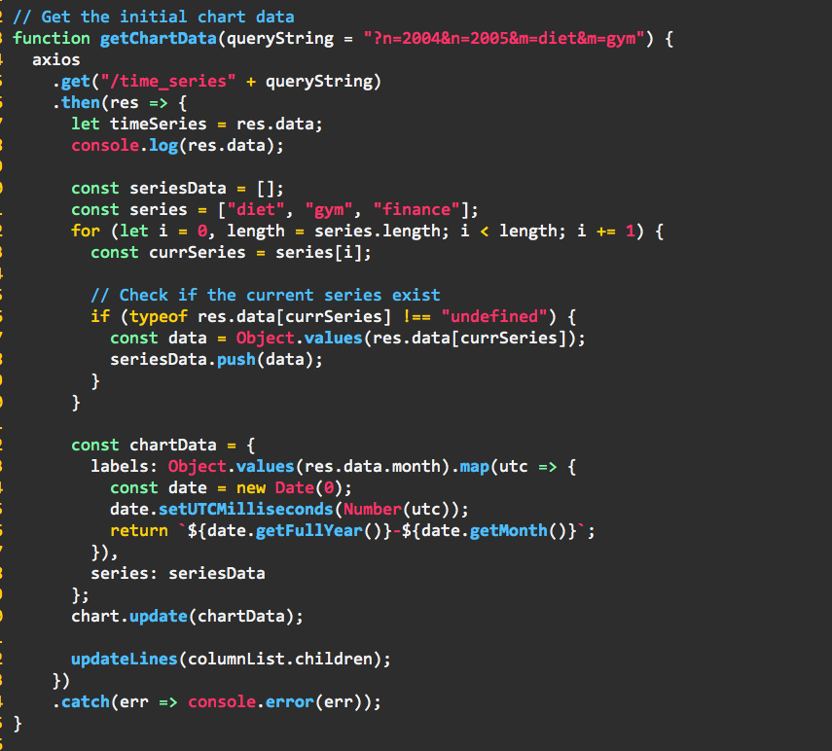
Grabbing chart data
This is a lot to digest, so lets break it down at a higher level first:
We use axios to create a get request to our backend + the query string.
We create a list of series data from the json data provided to us by our dataframe.
setup our chart data object (labels and series data)
update the chart and lines drawn to the screen.

Slide 24
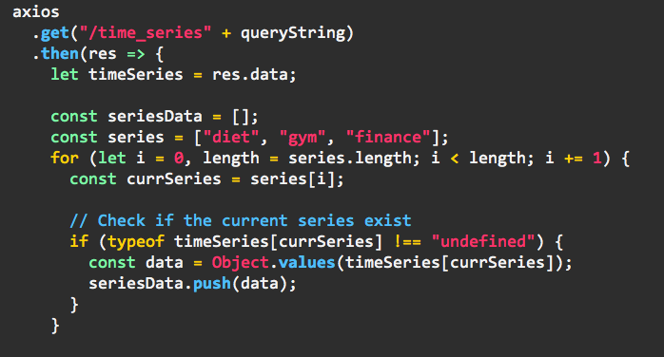
Sending the request and grabbing data
Using the query string passed into the function by default or specification, we create a request to the endpoint we had setup earlier. With the response, we then grab the series Data that we’re going to be drawing to the chart if it was returned in the response.

Slide 25
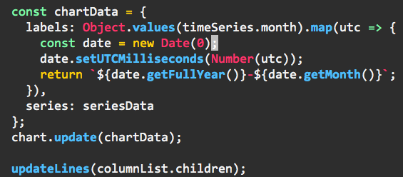
Create chart data
We create the chart data object which is what will be used to update our chart with our time series data.
labels - defines our labels that will be used on the x axis for our points.
series - defines our series data that will be plotted on the y axis

Slide 26

Final catch!
attached to our axios.get(...).then(...) should be the snippet on the right, looking like this
axios.get(url).then(res…).catch(err…)
(refer back to slide 22 to see the entire function)

Slide 27
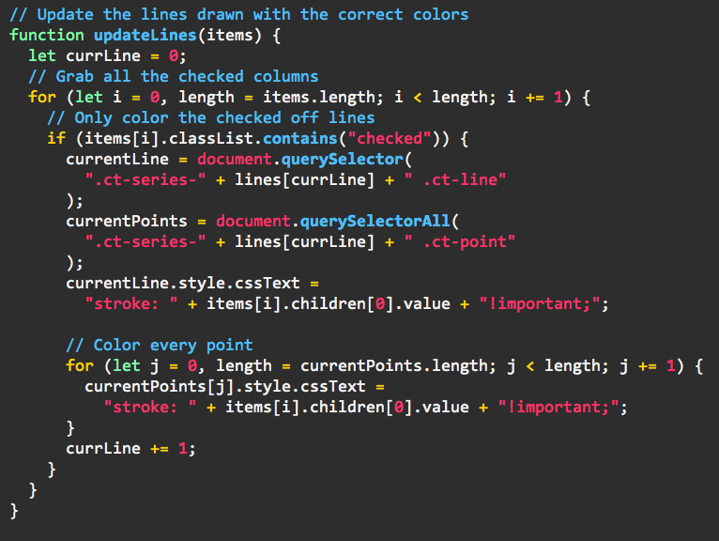
Updating the lines
Updating the lines looks very complicated but is not. All we do is iterate over the columns that are allowed to be selected by the user.
We check if they’re selected and if they are, color the line and points of the data being plotted on the chart. We use the lines array that we previously mentioned we would explain. Chartist uses letters for which lines are being colored, so we need to make sure that lines are being colored properly.

Slide 28
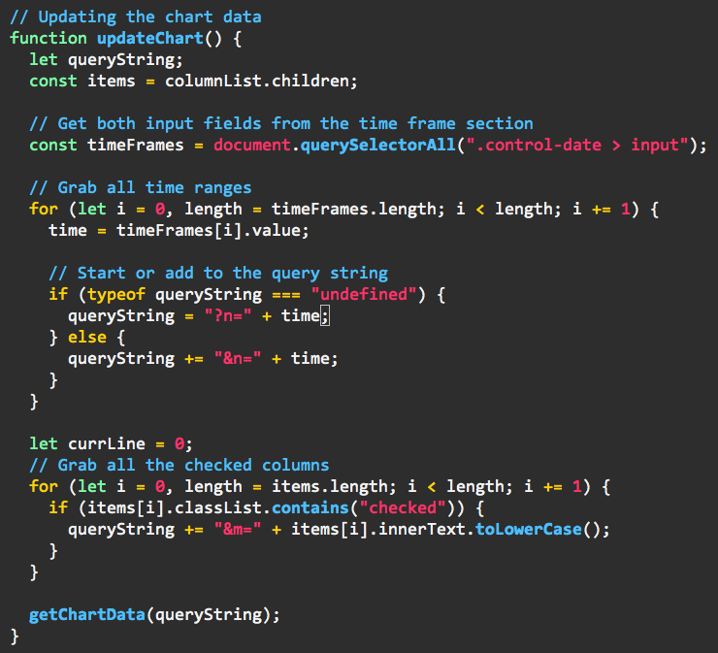
Updating the chart
This is the function we use to create the query string for when we need to update the data we’re going to be plotting on the chart. We generate the query parameters by going through both the time frames and columns that can be selected through our inputs.
Once the query string has been created, we then call our getChartData() function.

Slide 29
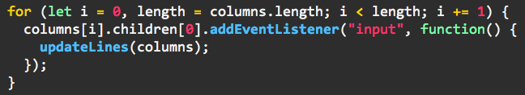

Finishing up
We add event listeners to all of our column color inputs so that the lines get redrawn when the colors are being updated.
To finish it all off, we place a initial getChartData() function call at the bottom to make our first request.

Slide 30
Closing thoughts
Clean up
Improvements
reduce function
handling the json manually (for better output)
Improving the slideshow

